Slide 1




Synapse presents
15 Oct 2023
Dialogflow Workshop

Slide 2
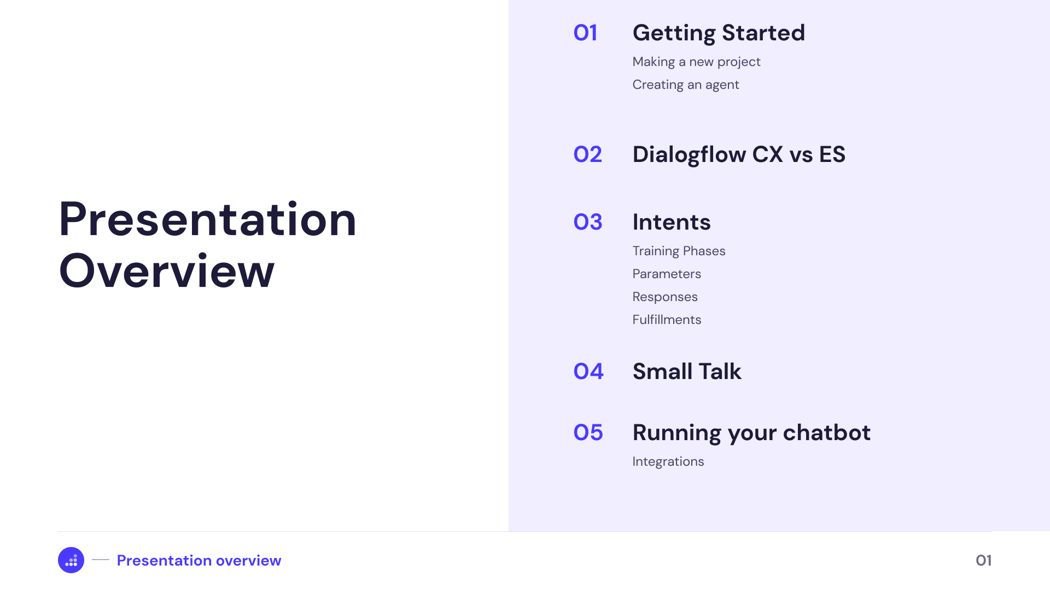

Slide 3




Dialogflow CX vs ES
Flows, Pages, State handlers
Conversation
Control
Intents and Contexts
Can handle large and complex agents
Agent
complexity
Can handle small to medium agents
Can be integrated with a large number of APIs
Can be integrated with a small number of APIs
Integrations
More expensive
Pricing
Less expensive
Version differences
02

Slide 4

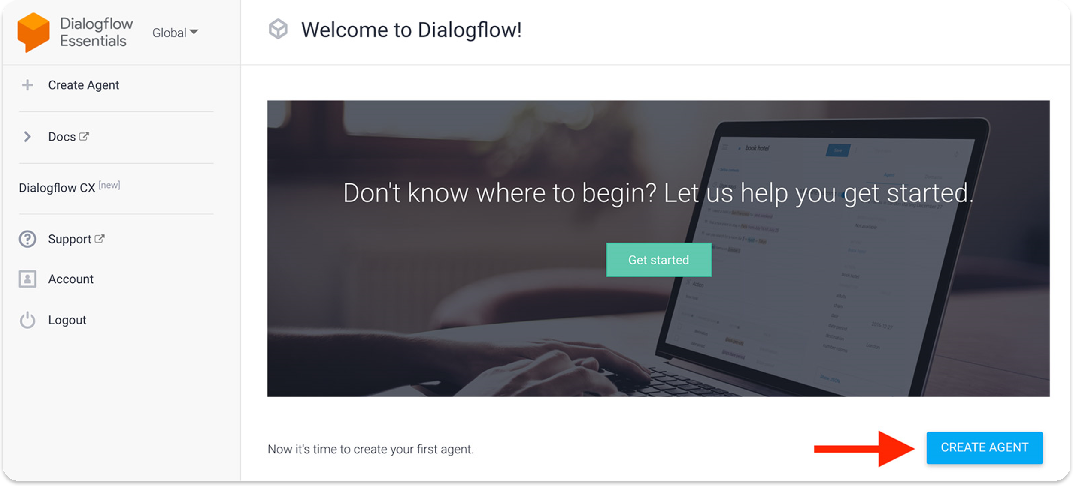
Starting out with your Dialogflow Agent
03

Slide 5
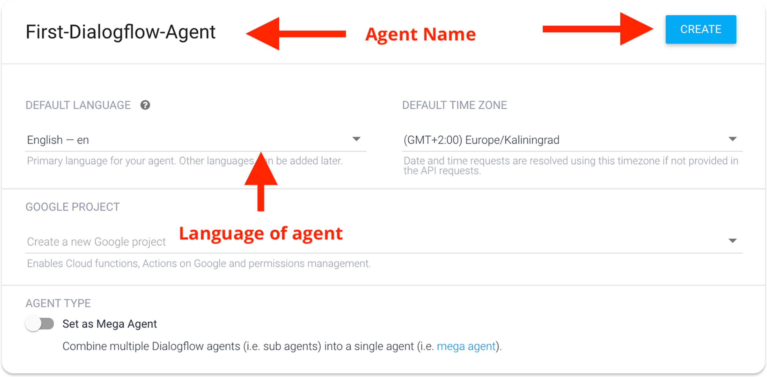
https://chatimize.com/dialogflow-tutorial/
Starting out with your Dialogflow Agent
04

Slide 6

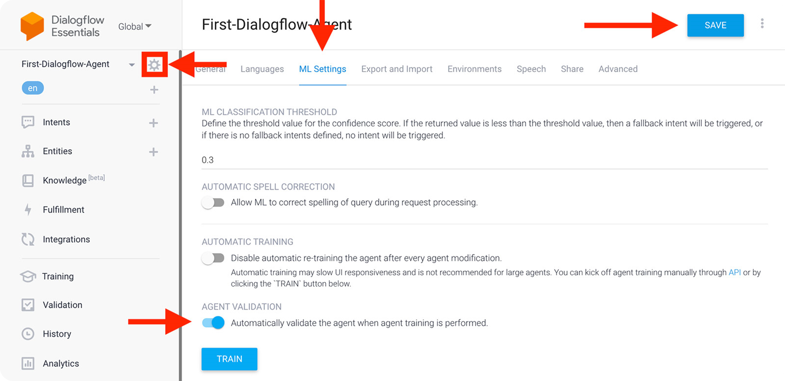
Starting out with your Dialogflow Agent
05

Slide 7

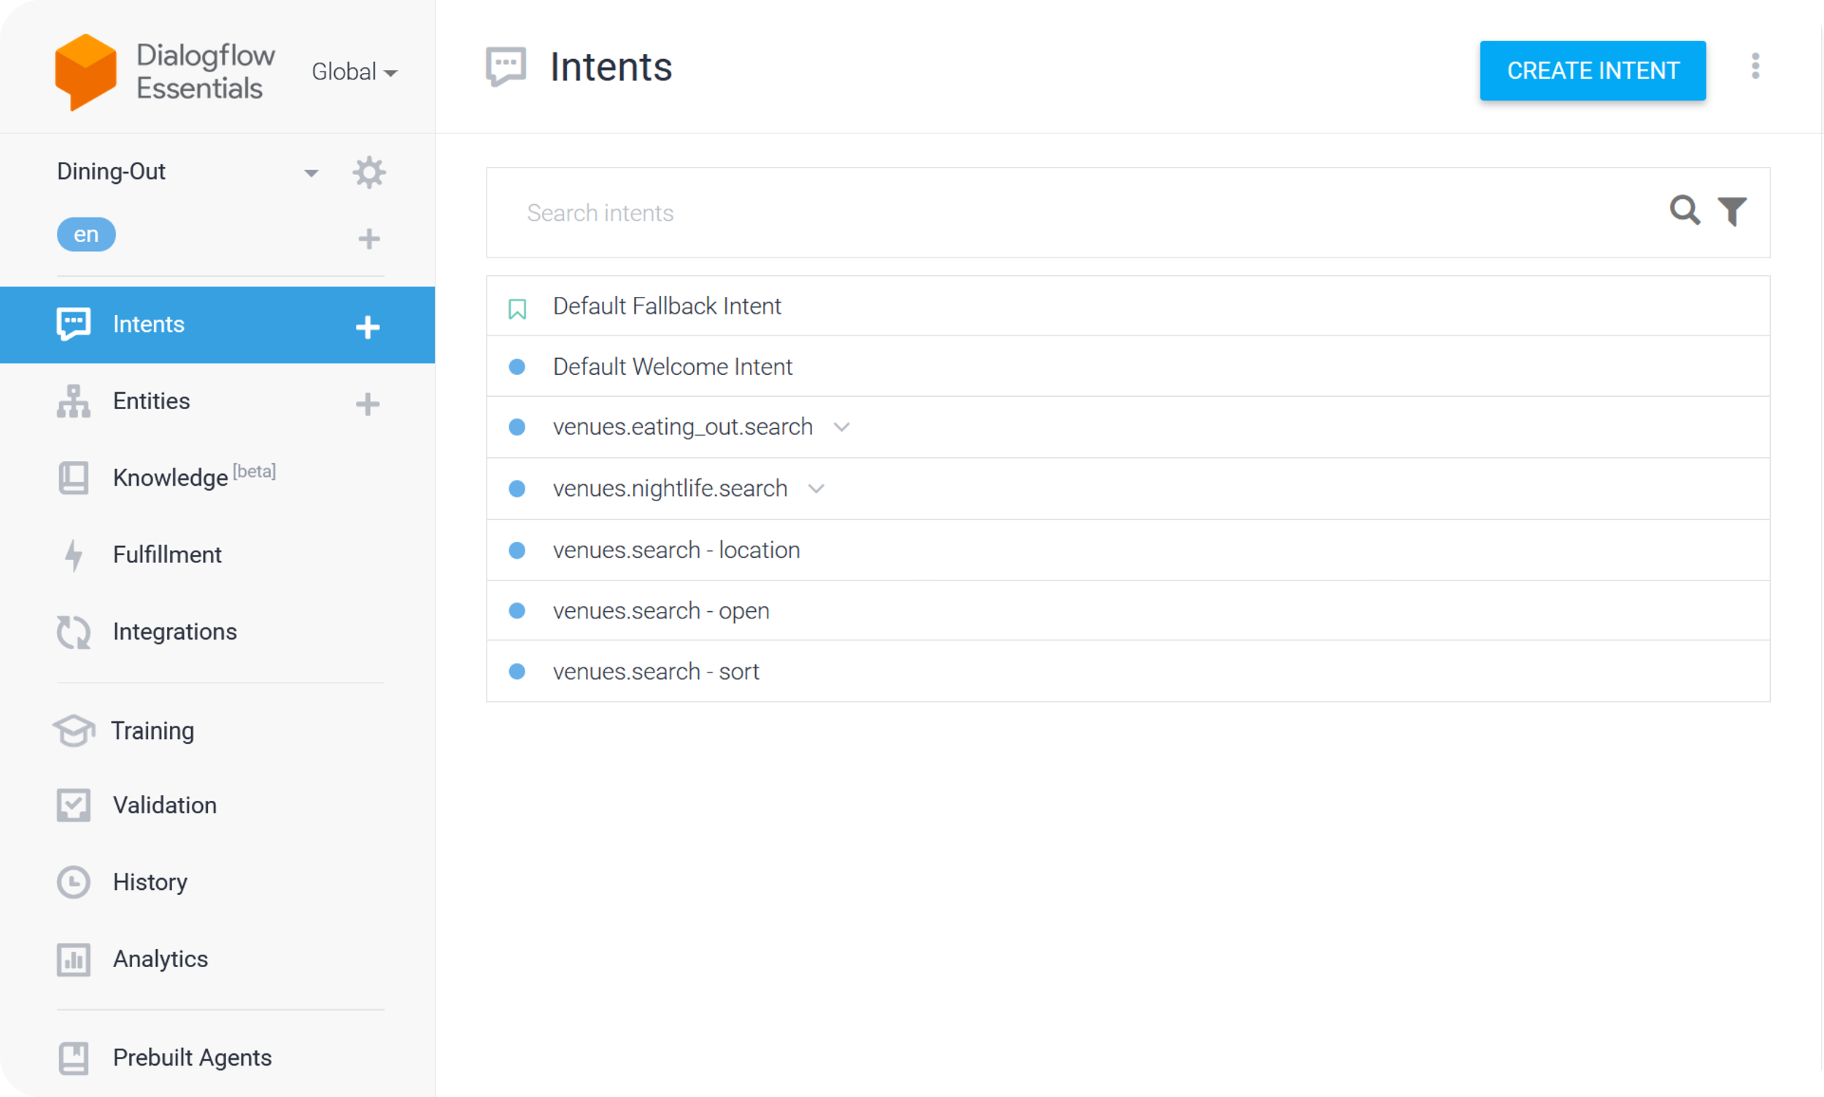
This is the central environment where developers design, build, and manage conversational agents (chatbots or virtual assistants).
They are essential for organizing and maintaining the conversational logic and content within Dialogflow ES.
Workspace
06

Slide 8


Training Phrases
Parameters
A list of example sentences or phrases that users might use to express their intentions. These training phrases help the AI understand and recognize user input.
Variables extracted from user input that provide important information, such as dates, locations, or names.
Responses
Fulfillments
The predefined messages or actions that the chatbot should generate as a reply to a user's request. These responses can include text, speech, or actions like calling an external API.
The code or logic that is executed when the intent is matched, which allows you to implement custom business logic, data retrieval, or other processing.
07

Slide 9


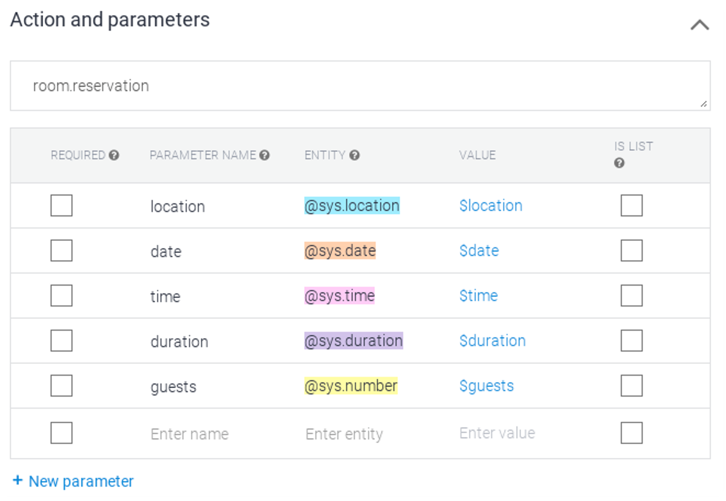

Parameters are variables used to extract and store specific pieces of information from user input during a conversation. Parameters enable the chatbot to generate relevant responses and perform actions. These extracted values can be utilized to customize responses and execute tasks.
Parameters
08

Slide 10
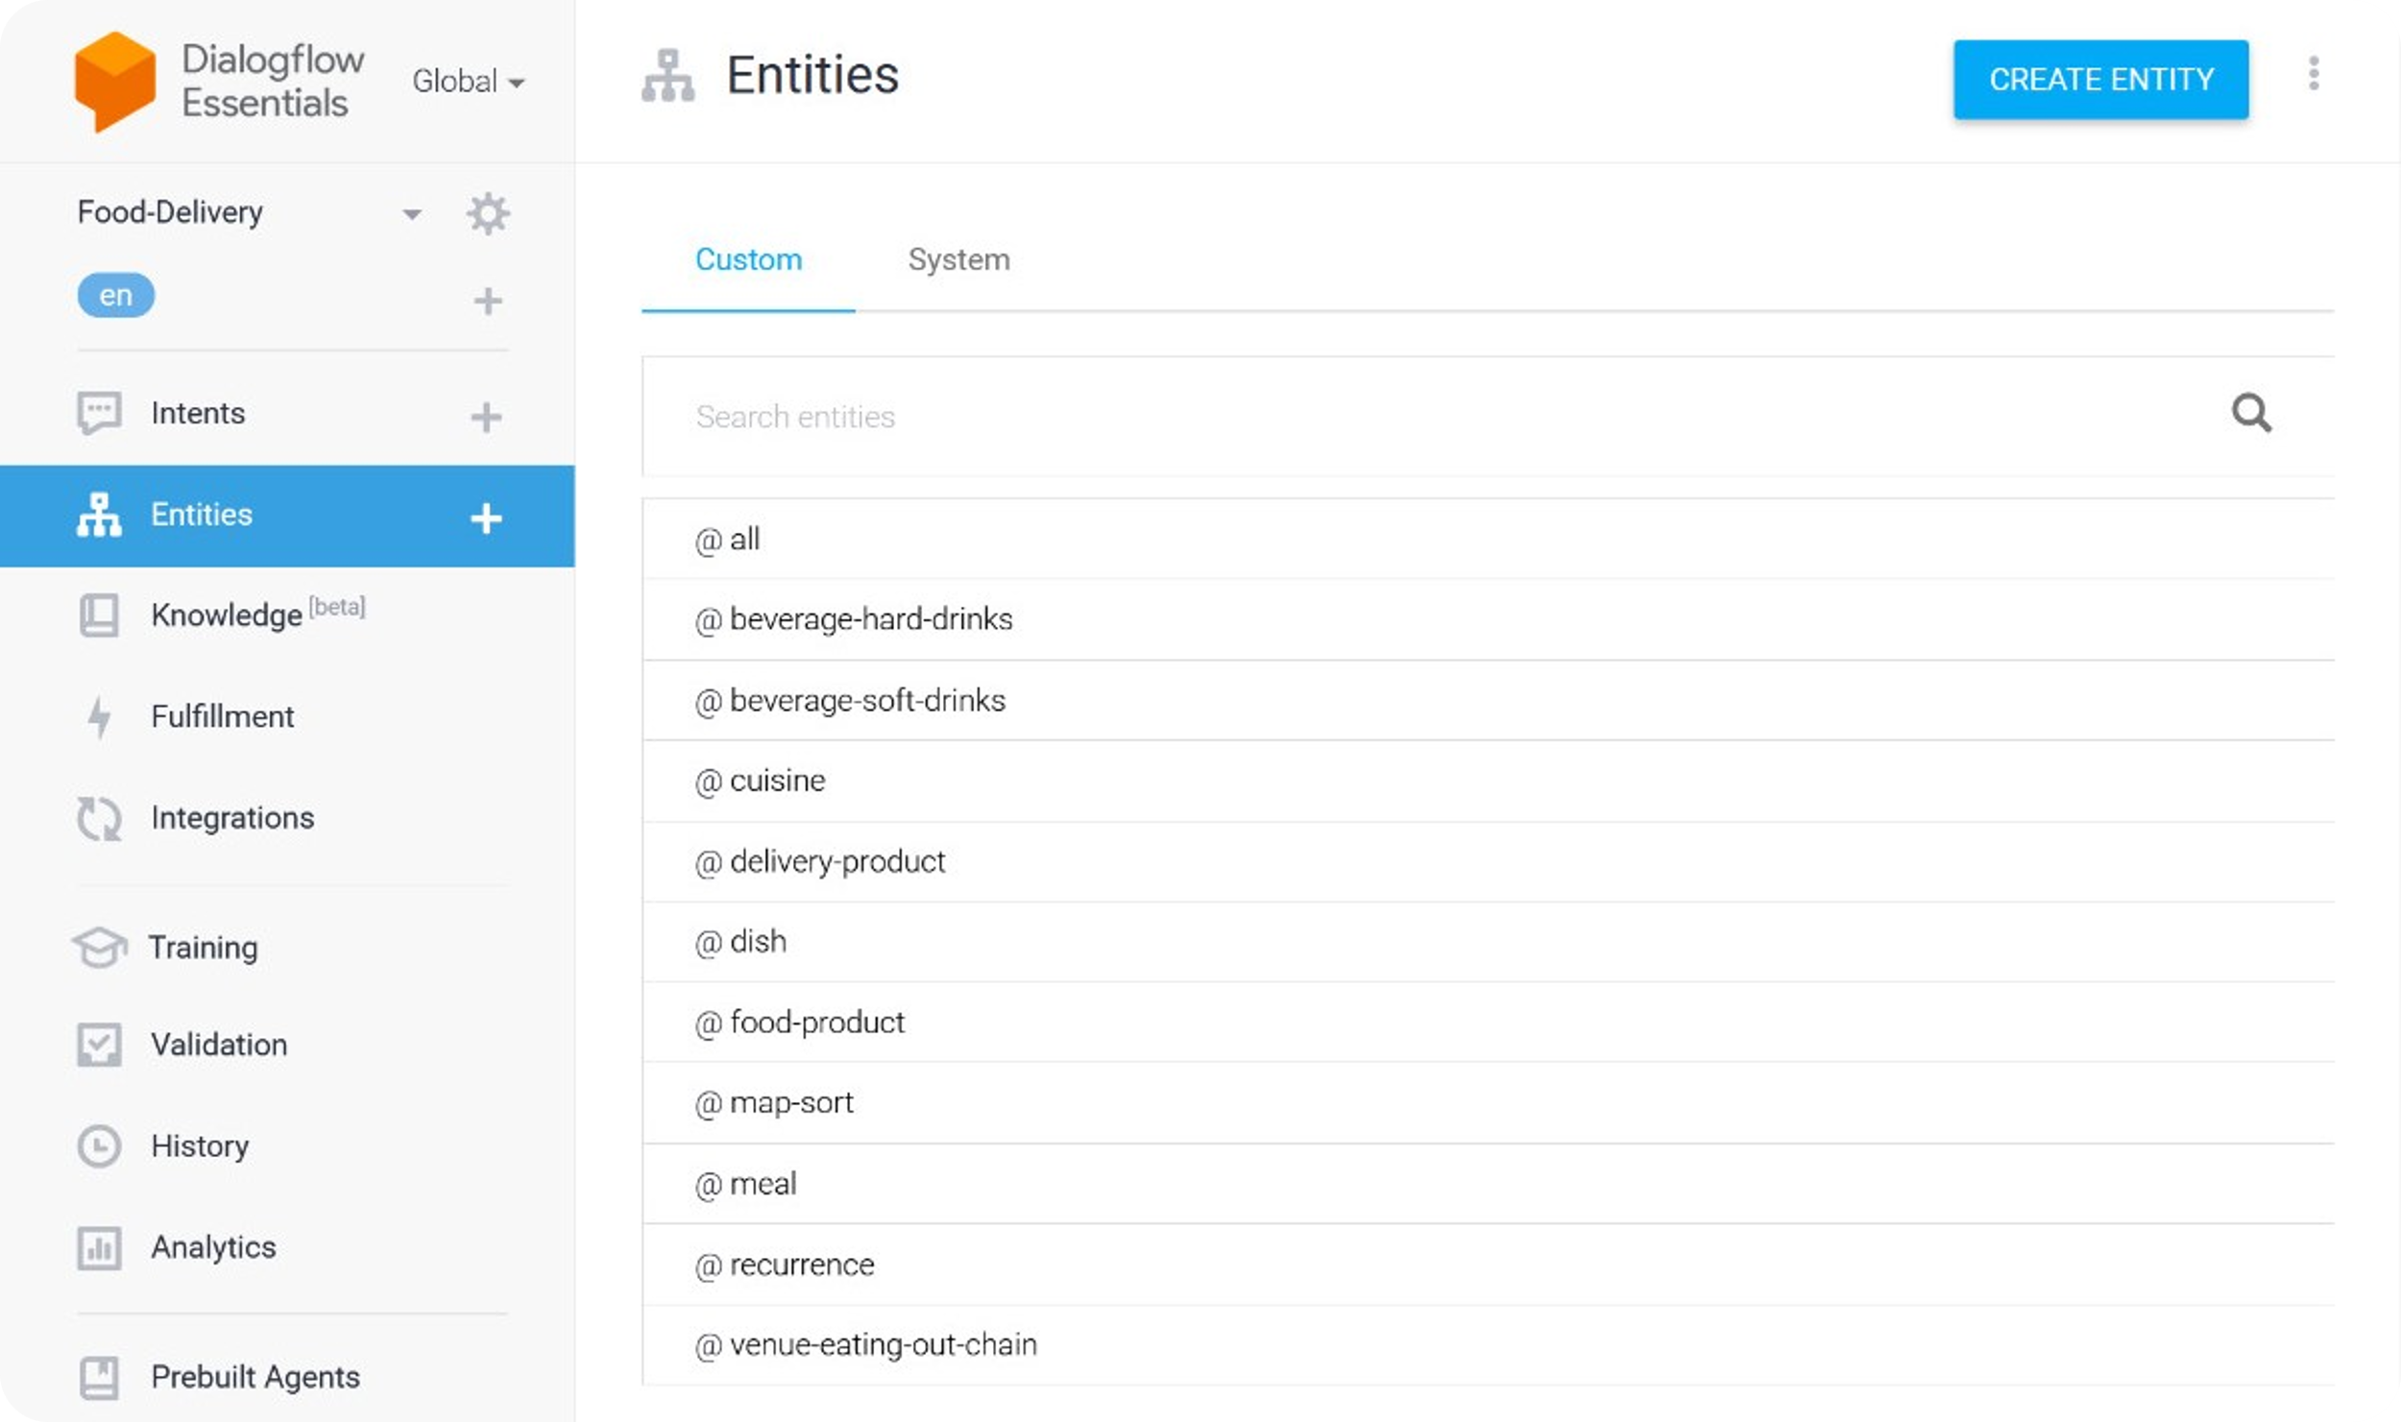
Entities in Dialogflow ES are placeholders for specific data types in user input.
They can be system-defined (like dates and numbers) or custom-defined, and they can have synonyms for variation.
09

Slide 11
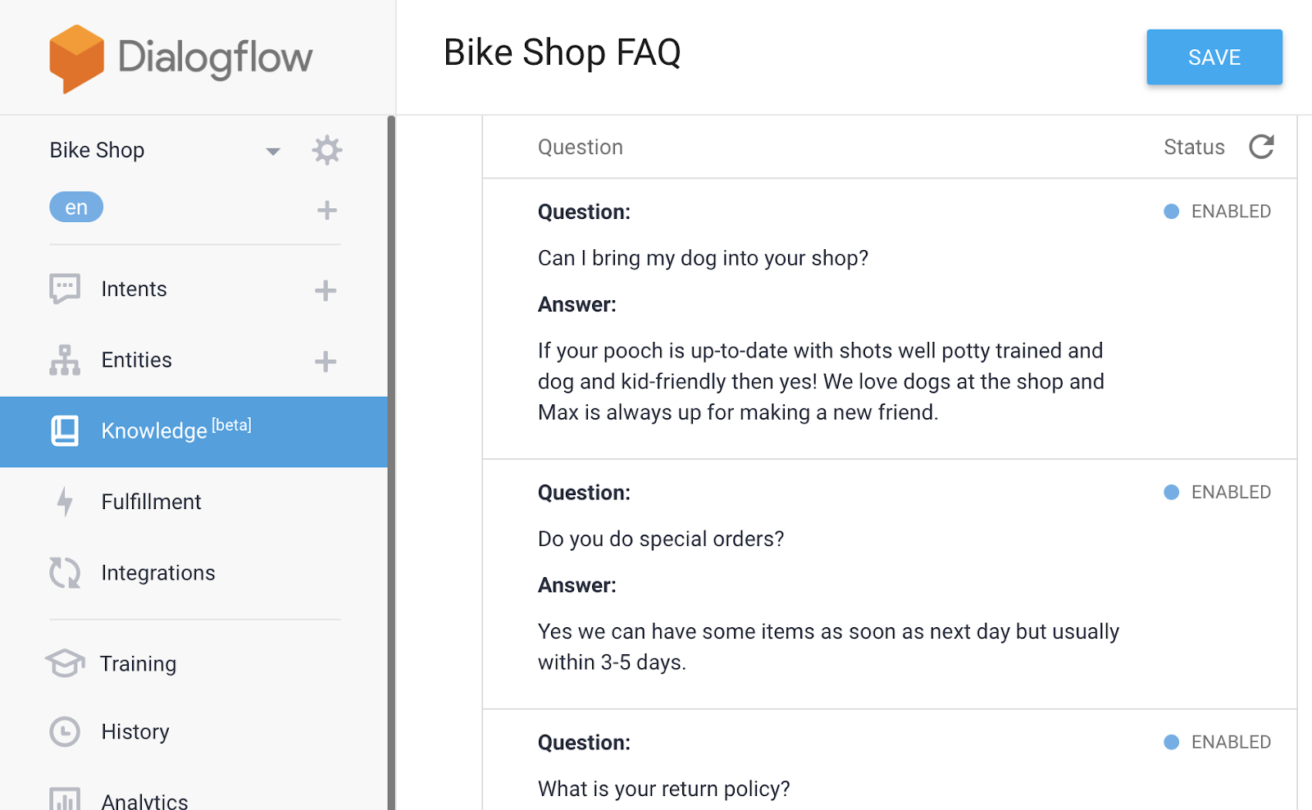
Knowledge in Dialogflow is a feature that enables chatbots to access a knowledge base to provide accurate responses to user queries by retrieving information from a predefined source.
09

Slide 12
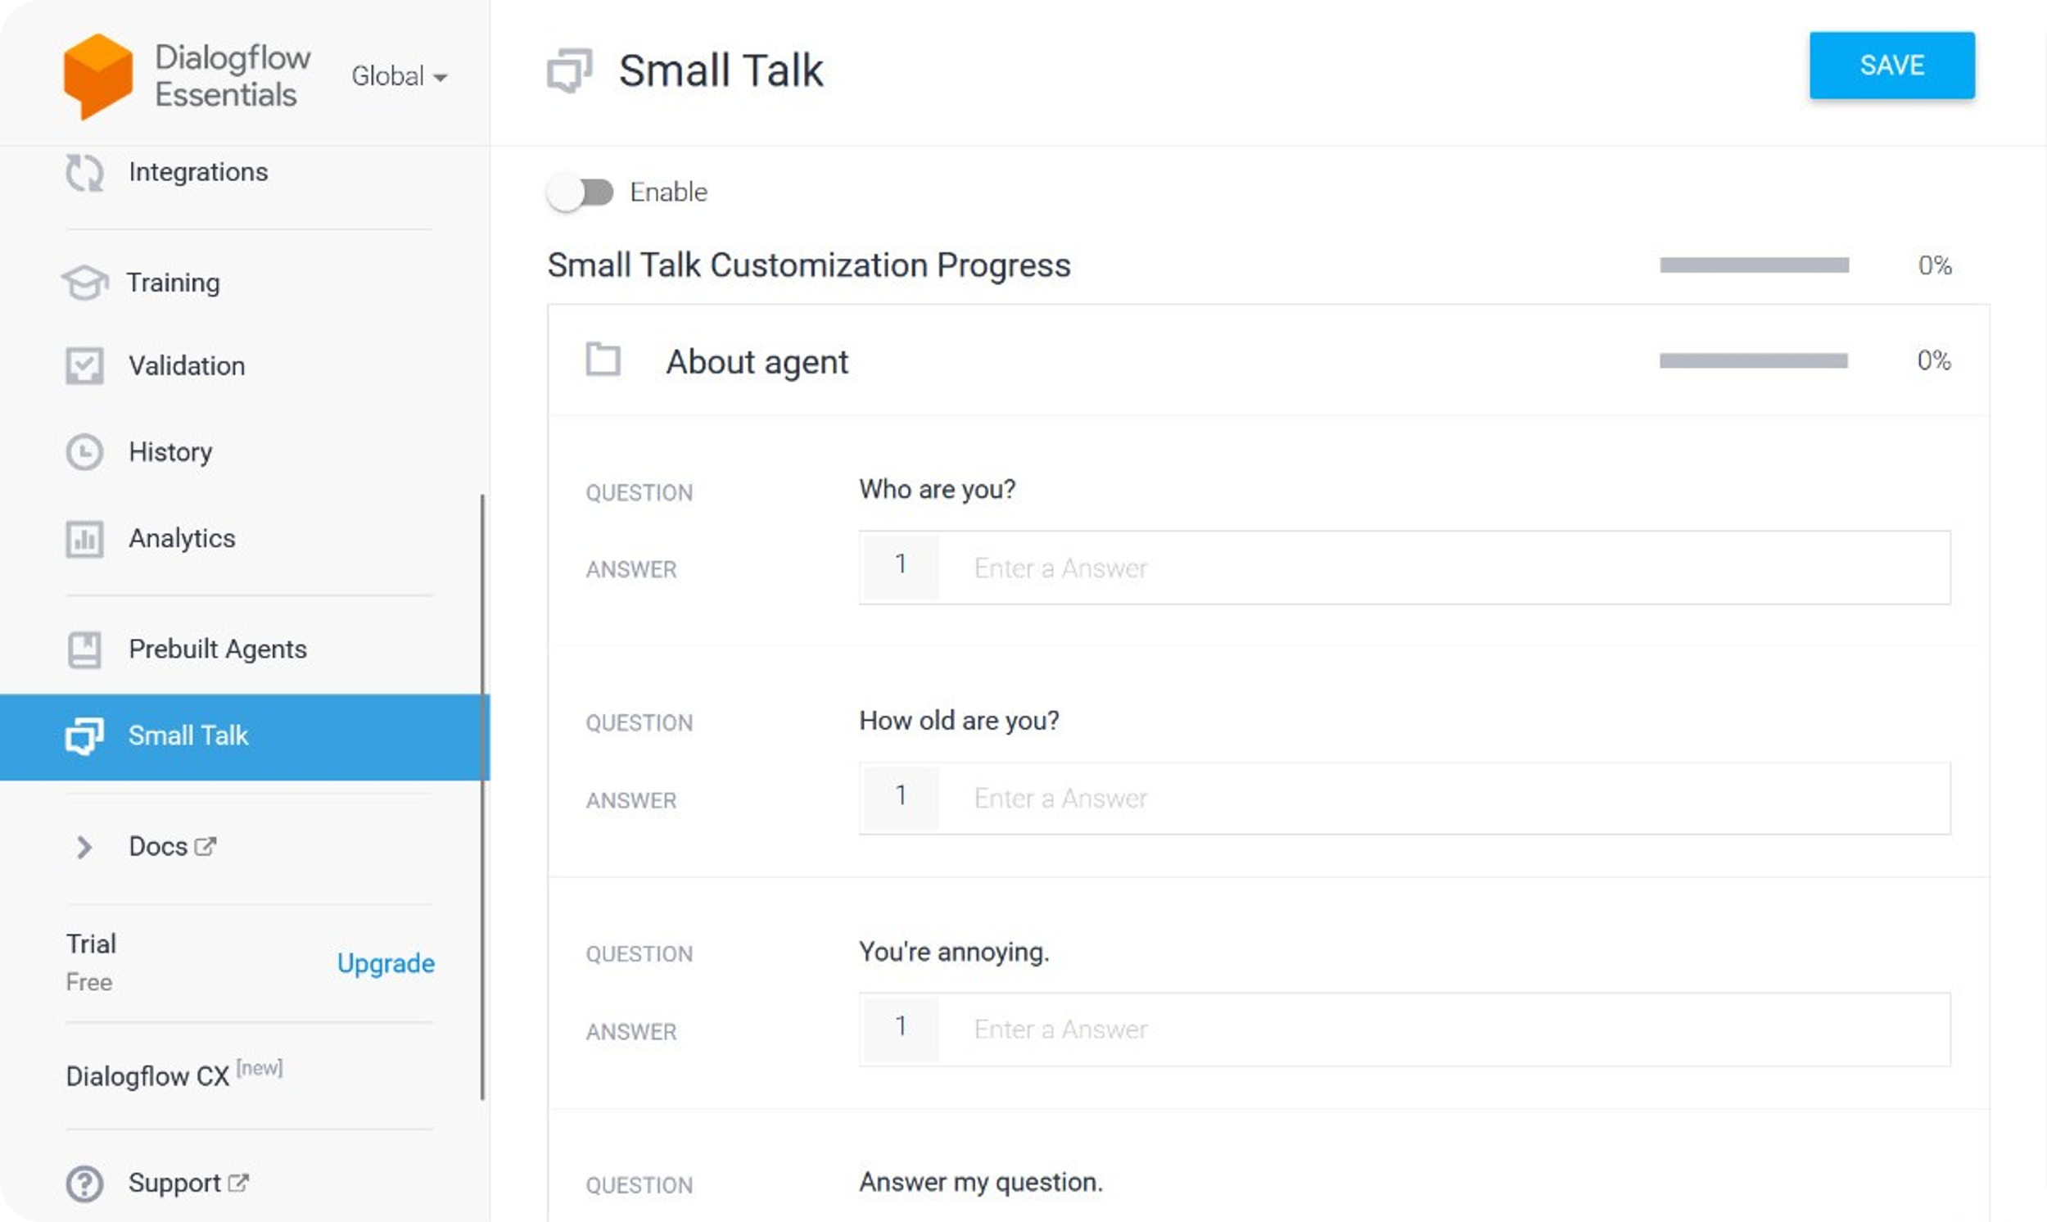
Small talk refers to a conversational feature that allows a chatbot to engage in casual and informal conversations with users.
With small talk enabled, a Dialogflow ES agent can respond to common conversational phrases, greetings, and social niceties.
10

Slide 13
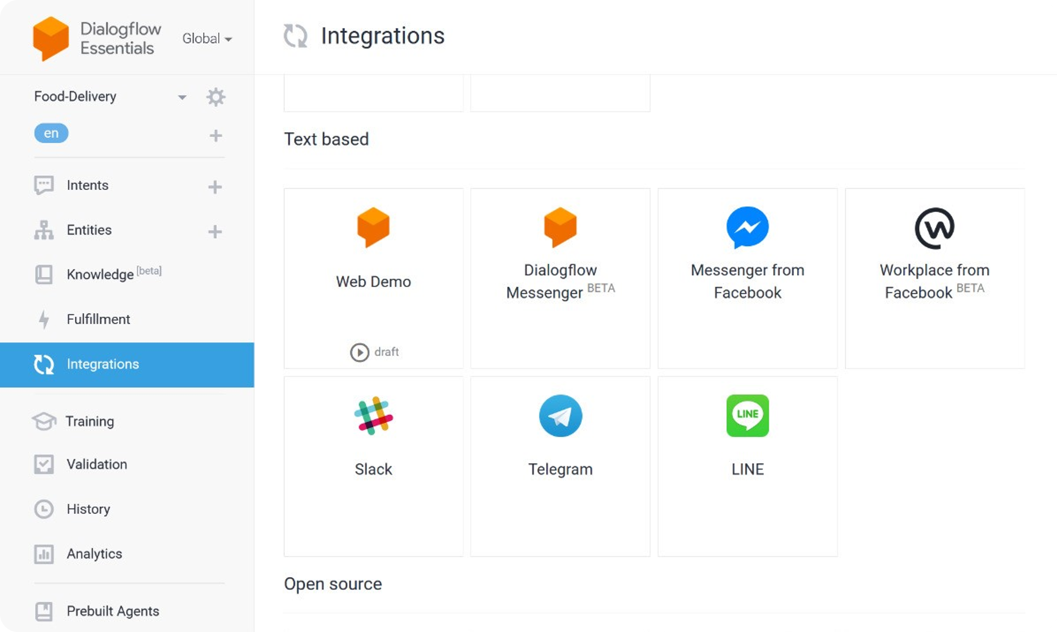
11

Slide 14
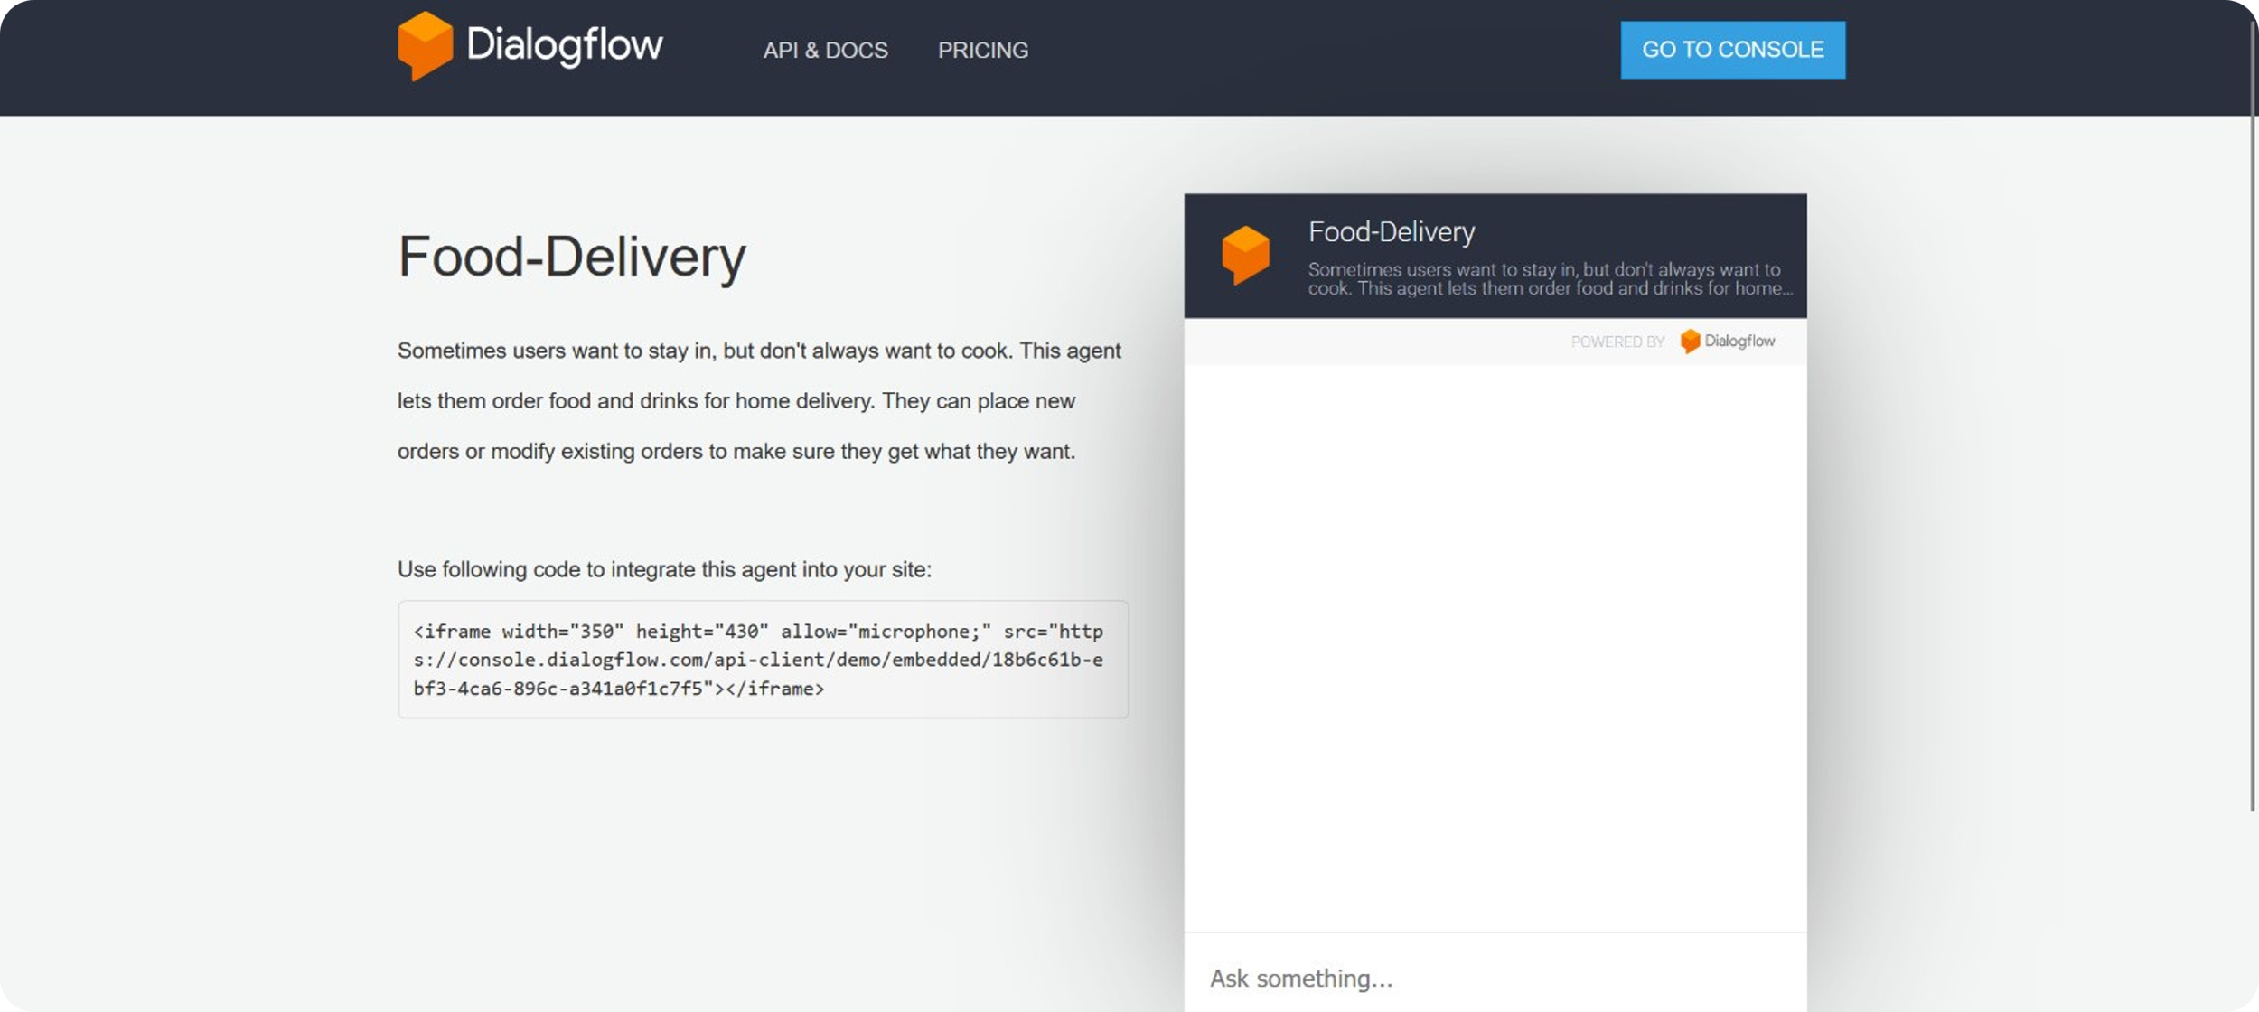
12

Slide 15

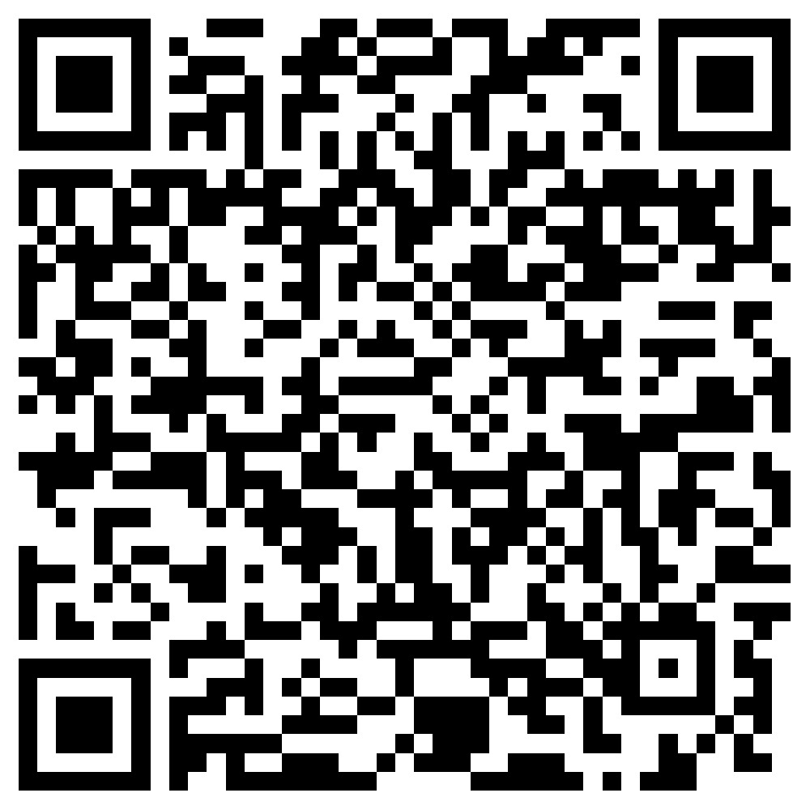

Slide 16






Thank you!

